Slide 1
Modernism & Post-Modernism

Slide 2
Modernism
Post World War I (1918)

Slide 3
Modernism Techniques
Sought to capture the essence of modern life through art work’s
Content
Theme
Plot
Setting
Characters
Form
The way the content is presented (style)

Slide 4
Modernism Techniques
Moved away from standardized formal writing & Questioned technique
Poetry – Free verse
Prose – move away from traditional plot diagram pattern

Slide 5
Modernism Techniques
Disjointed writing
Stream of consciousness
Writing de-emphasized Plot
Writing placed an emphasis on
Theme
Psychology of Character (Character Motivation)

Slide 6
Modernism Techniques
Conflict is not resolved at the end
Mirrors life
Why live happily ever after in a story if that’s not what always happens in real life?

Slide 7
Modernism Ideas
An isolated Hero
Because he isolates himself
Because others isolate him
Writing reflects feelings of uncertainty and disillusionment

Slide 8
Modernism Ideas
This era was marked by an end of optimism
Because of the war’s devastation.
Author’s do not idealize the universe
Sees things realistically
Pain & Suffering included

Slide 9
Post-Modernism
Began Roughly between 1965 - 1975

Slide 10
Post-Modern Techniques
Changes in technology influences :
Content
Form
Presentation
Multi Media in nature

Slide 11
Post-Modern Techniques
Emphasis on character motivation

Slide 12
Post-Modern Ideas
Stories are often (but not always!):
Science Fiction
Magical Realism: realistic with a magical element
Stories are non-linear in terms of time
Suggestive of alternative universes
Examples
The Butterfly Effect
Memento
Inception
Donnie Darko

Slide 13
Post-Modern Ideas
Reject GRAND NARRATIVES and their myths
May include stories that have an effect on culture
The Bible
Westerns (U.S.)
Ancient Greek Mythology

Slide 14
Post-Modern Ideas
Do NOT trust history (all history is biased)
“truth” is individualized
There is no absolute truth
History written by winners
What do losers have to say about things?

Slide 15
Post-Modern Ideas
Tend to look at things on small scale
A localized focus rather than the big picture
No difference between people

Slide 16
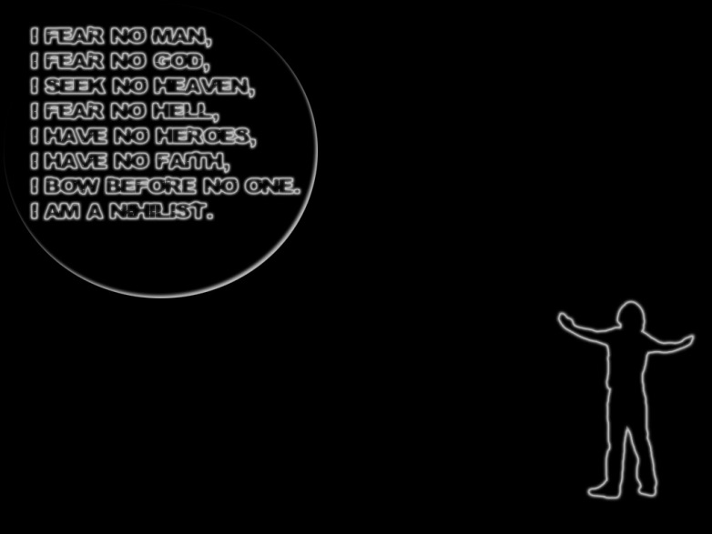
Post-Modernism Ideas
Tends to be Nihilistic
Philosophical view
Hardcore Skepticism
Ultra-Pessimistic
Rejects an & all belief systems

Slide 17
Post-Modern Ideas
Concerned with
Social Issues as writers align with feminist and ethnic groups
Erodes distinctions between classes and people

Slide 18
Today…
Decide who you are working with (or alone)
Decide Option 1 or Option 2
Brainstorm your ideas

